Slide 1

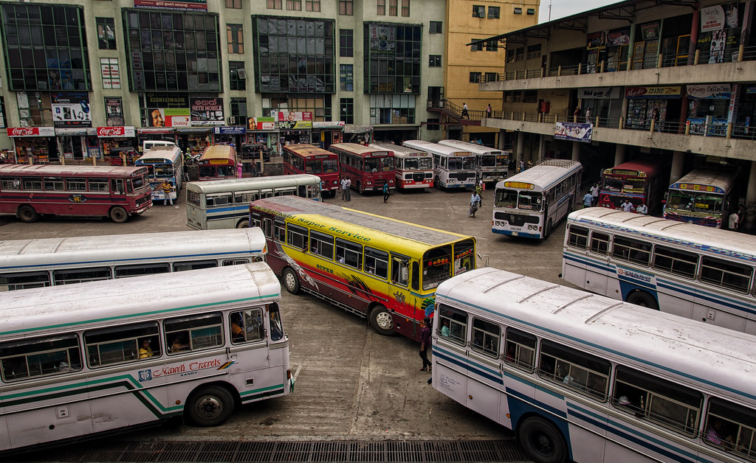
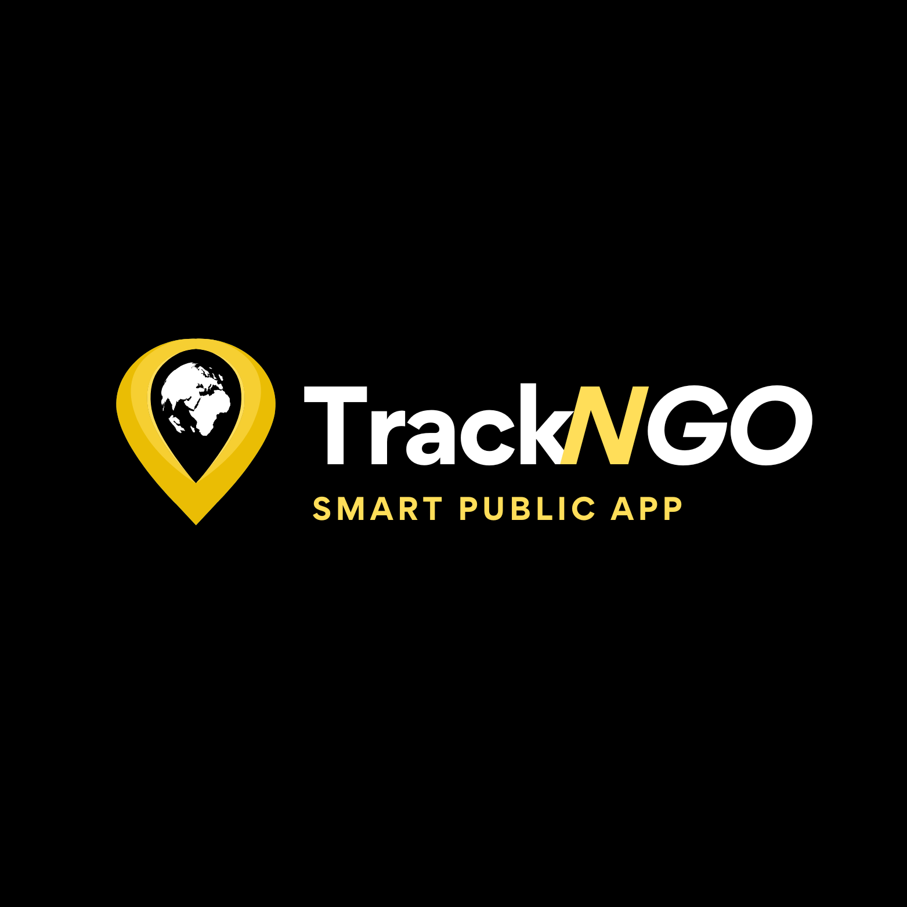

Slide 2
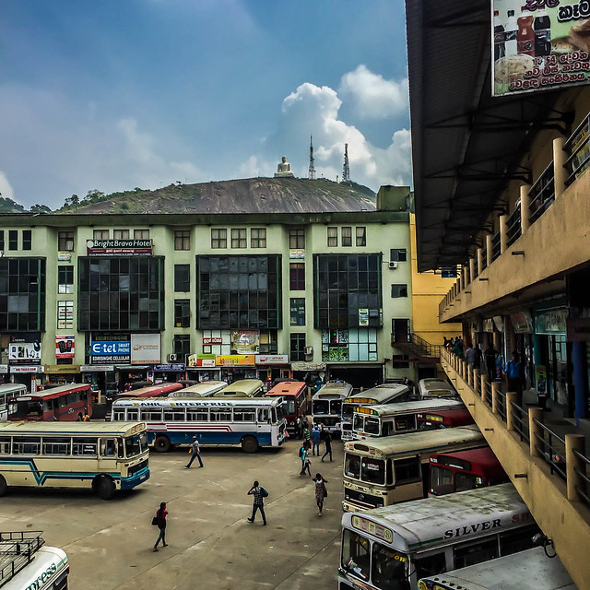

Introduction
Public transportation is vital for urban life, but Sri Lanka’s bus system struggles with long wait times, outdated schedules, and inefficient routes, frustrating commuters. The TrackNGo web app addresses these issues with GPS tracking and real-time route planning, allowing users to view live bus locations, plan routes, offer relevant content and news, report lost items enhancing the commuting experience.

Slide 3
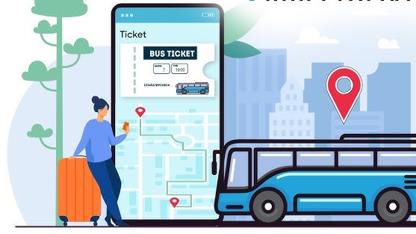
Project Objective
To develop a smart bus transportation app that improves commuting in Sri Lanka by offering:
Real-time tracking
Updated schedules
Fare estimates
Lost-and-found system
Objective: Make public transit more accessible, reliable, and efficient, helping users plan journeys with ease.

Slide 4
background
Sri Lanka’s public bus system struggles with outdated infrastructure, causing unpredictable arrivals, inefficient routes, and manual fare calculations. Additionally, there is no centralized lost-and-found system. TrackNGo addresses these issues by integrating GPS technology for real-time bus tracking, fare calculation, and news updates, enhancing commuter convenience and optimizing public transport management.

Slide 5

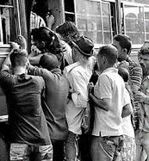
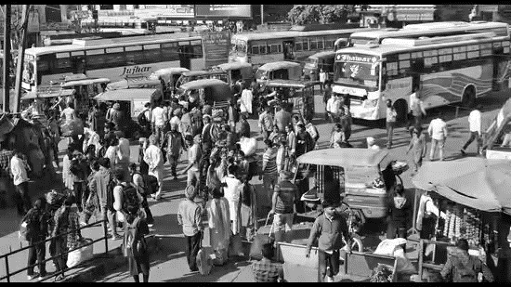
Problem Statement
Challenges in Sri Lanka's Bus System:
Extended wait times.
Outdated schedules.
Poor route optimization.
Impact: Frustrating experience for urban commuters.
Issues: Lack of real-time updates and route planning.
Need: A tech-driven solution to enhance accessibility, efficiency, and reliability in public transport.

Slide 6
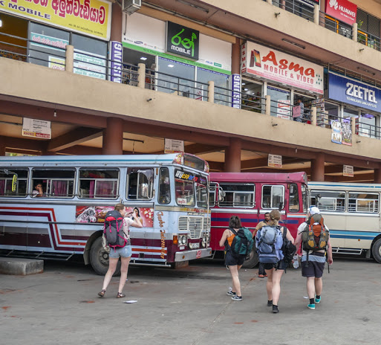

Proposed Solution
Real-Time Tracking: Live bus locations to reduce wait times.
Updated Schedules: Access the latest bus schedules anytime.
Lost & Found: Report and track lost items easily.
Fare Calculation: Fare estimates based on route.
News & Insights: Transport info plus relevant news updates.
Reporting System – Report Drivers behaviors throughout the Ride

Slide 7

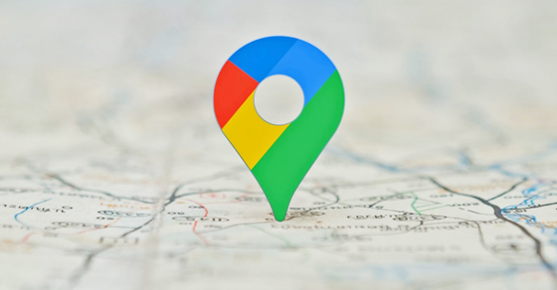
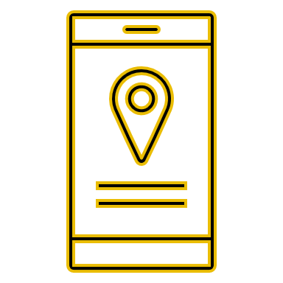

Functional Requirement
Real- time Tracking
Route Management
Schedules and Times
Fare Estimation
Lost item Reporting
Feedback and Reporting
News and Insights
Admin Dashboard for Conductors

Slide 8

Non-Functional Requirement
Performance
Reliability
Scalability
Usability
Security
Availability
Maintainability

Slide 9
Technology used
Frontend Tools:
– React for dynamic user interfaces.
- Tailwind CSS: For responsive and accessible desi
• Backend Tools:
– Node.js with Express for creating APIs.
– MongoDB for database management.
-- JWT (JSON Web Tokens): For secure authentication
• API Integration Tools:
– Google Maps API for GPS tracking and route navigation.
– News Api from NewsData.io

Slide 10

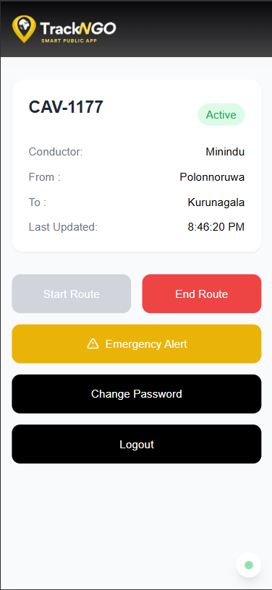
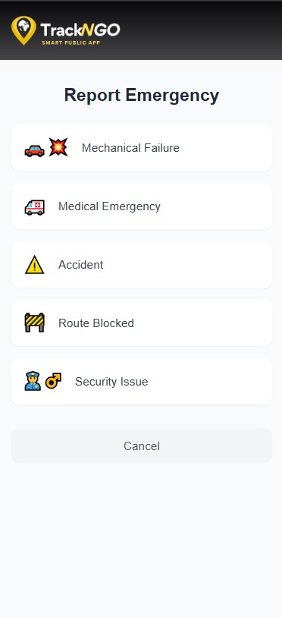
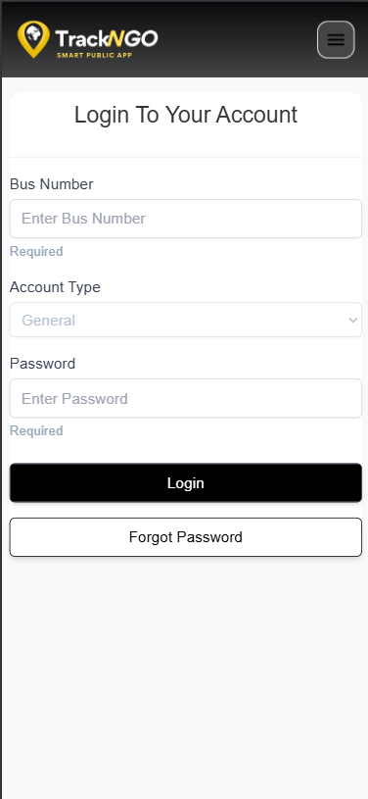
Final APP Interface

Slide 11
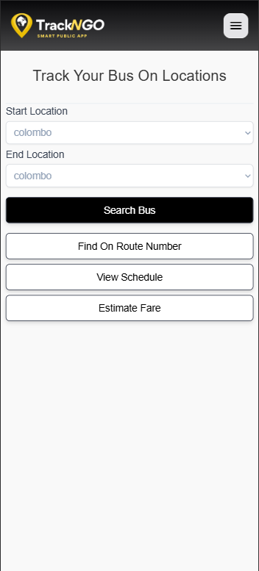
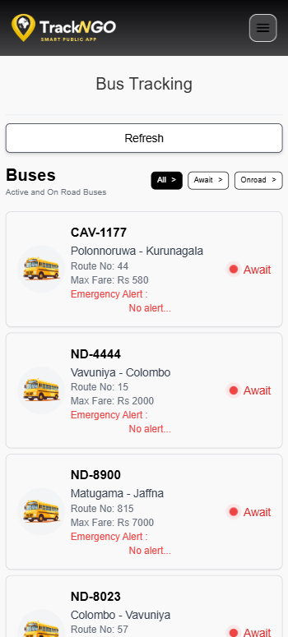
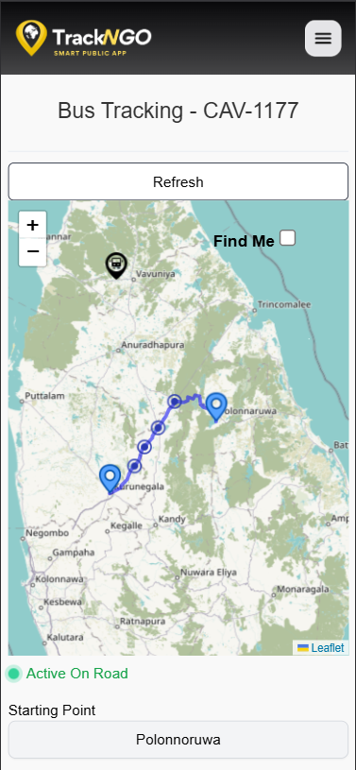
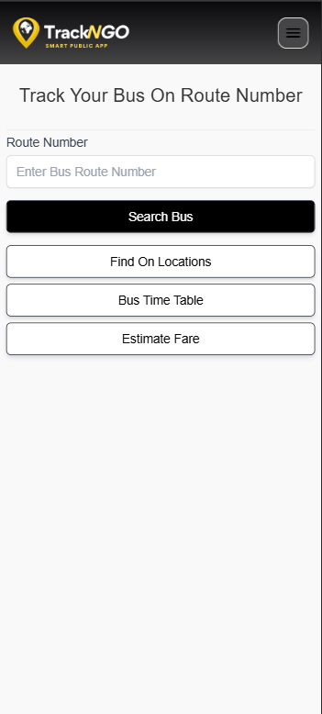
Final APP Interface

Slide 12
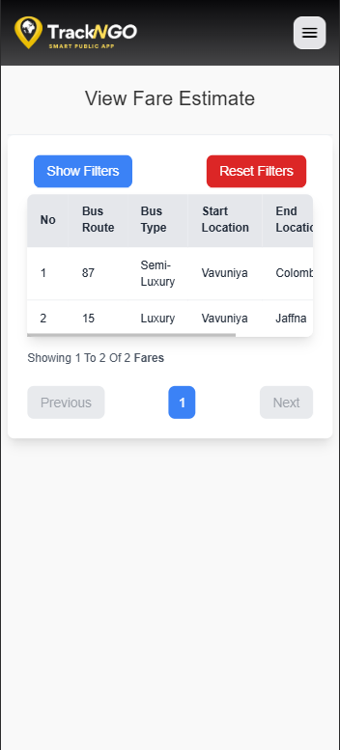
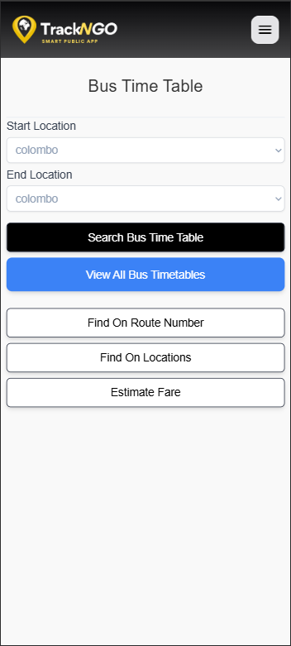
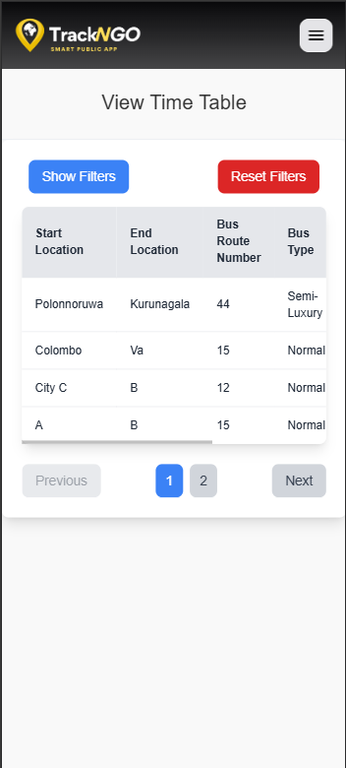
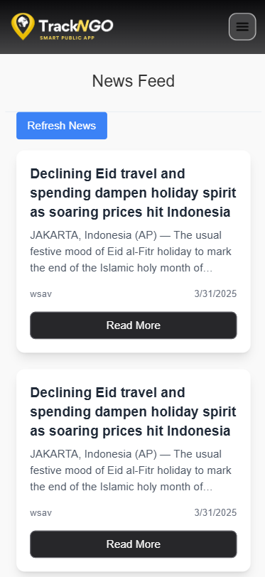
Final APP Interface

Slide 13
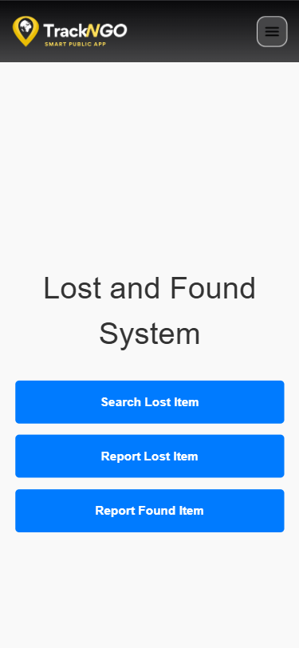
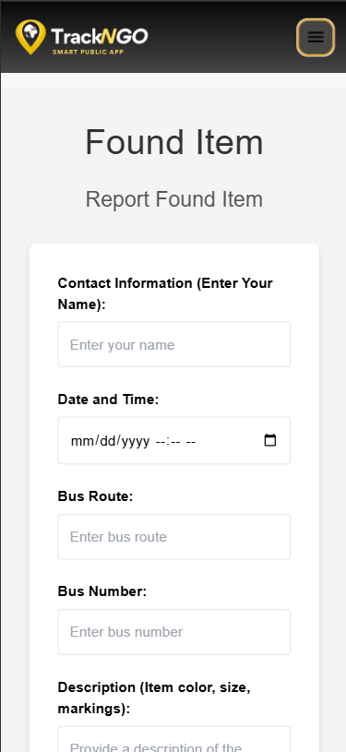
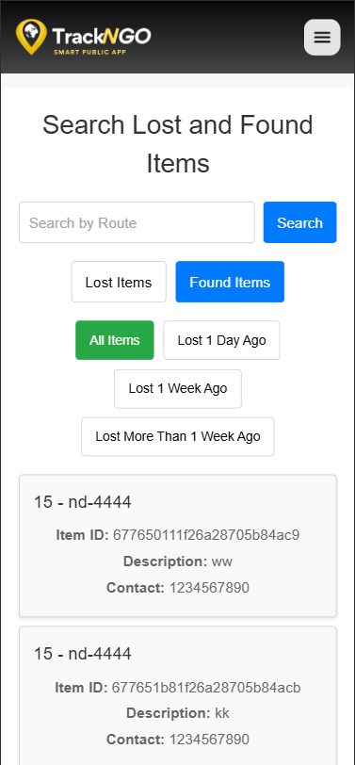
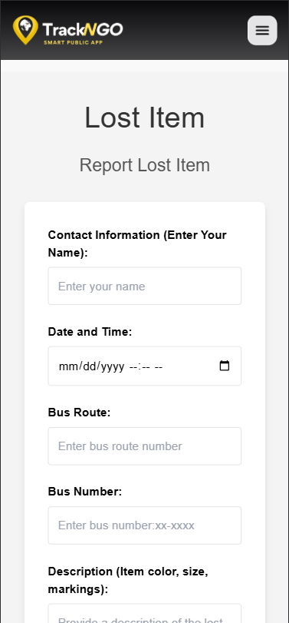
Final APP Interface

Slide 14
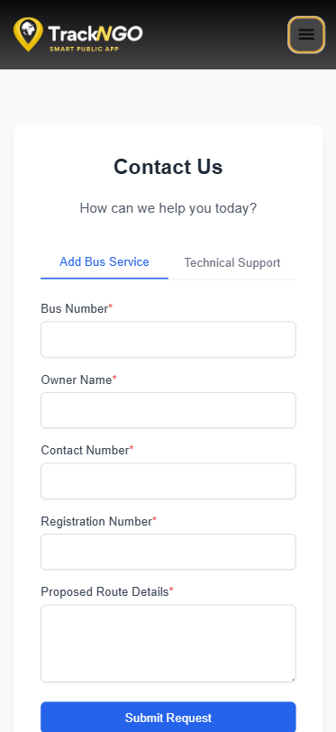
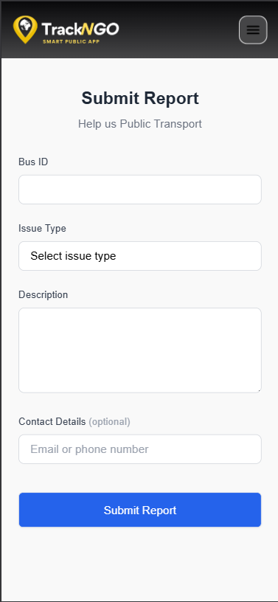
Final APP Interface

Slide 15
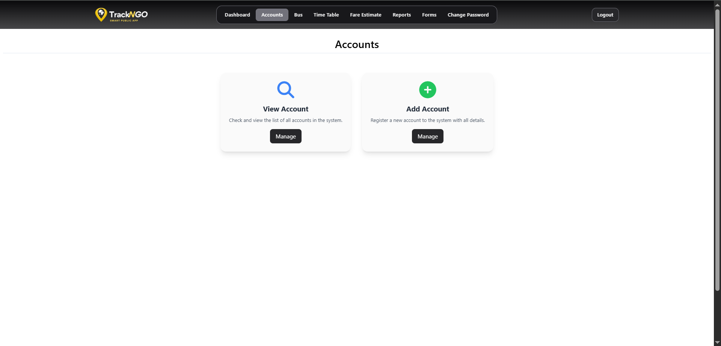
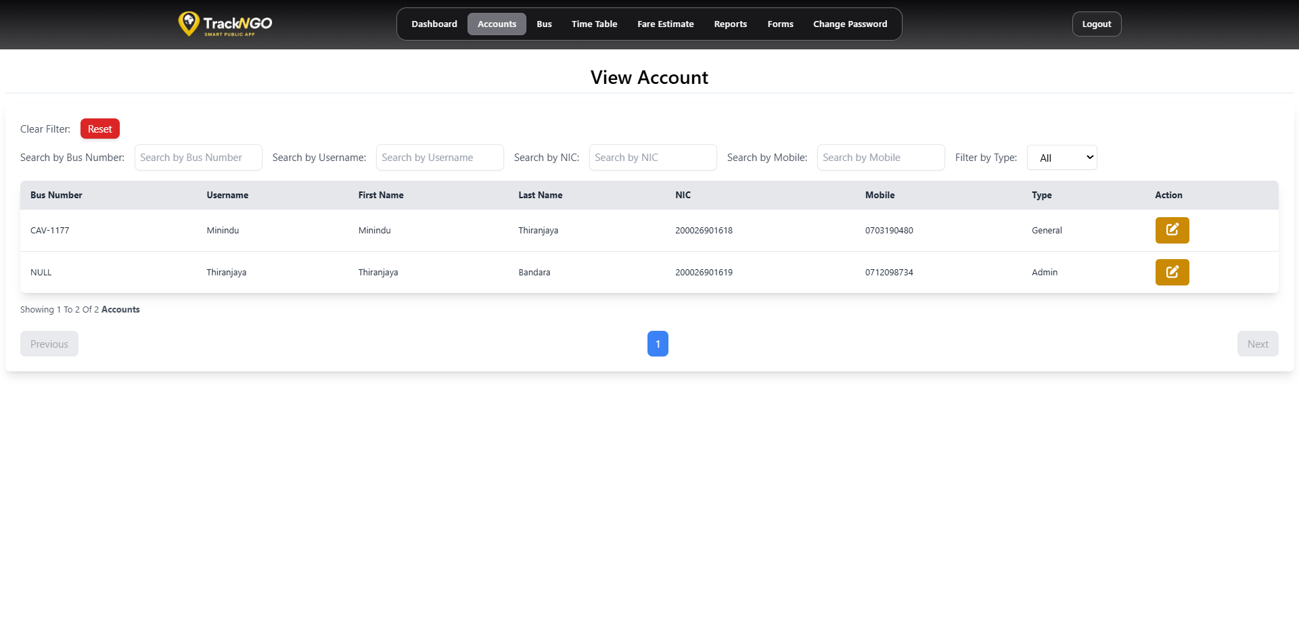
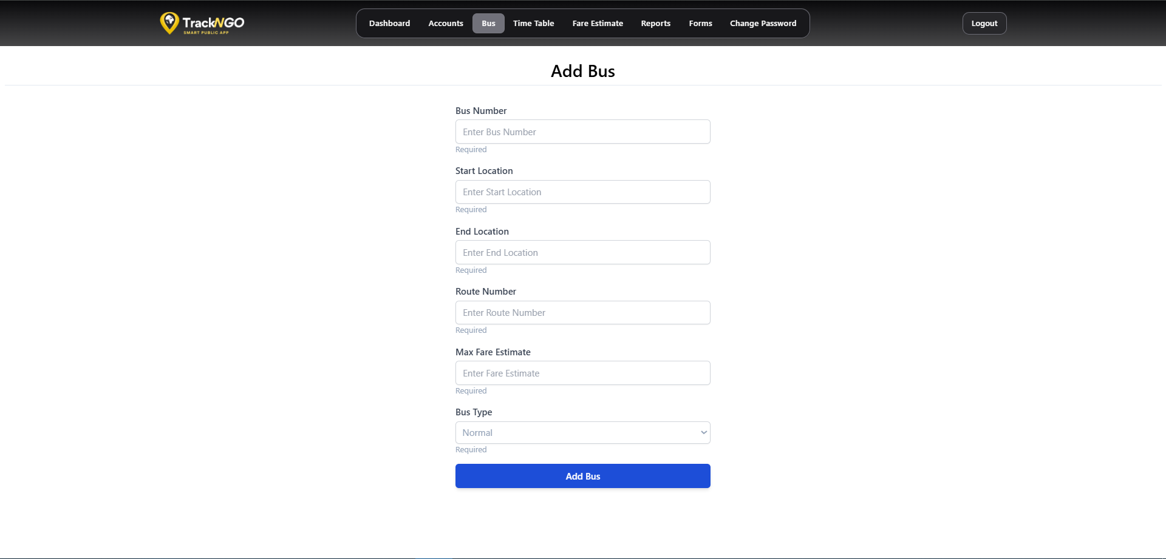
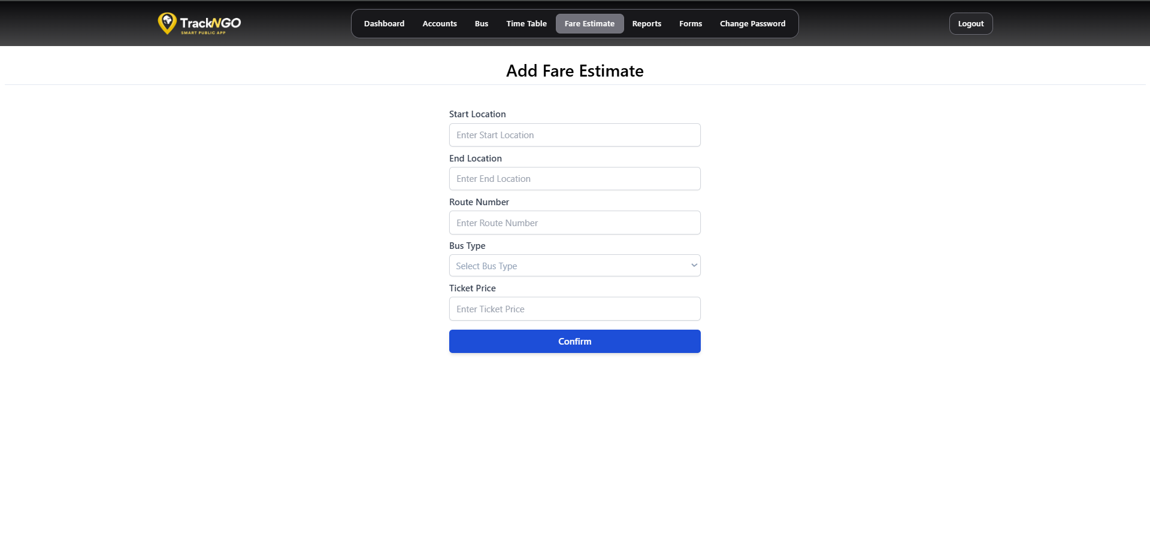
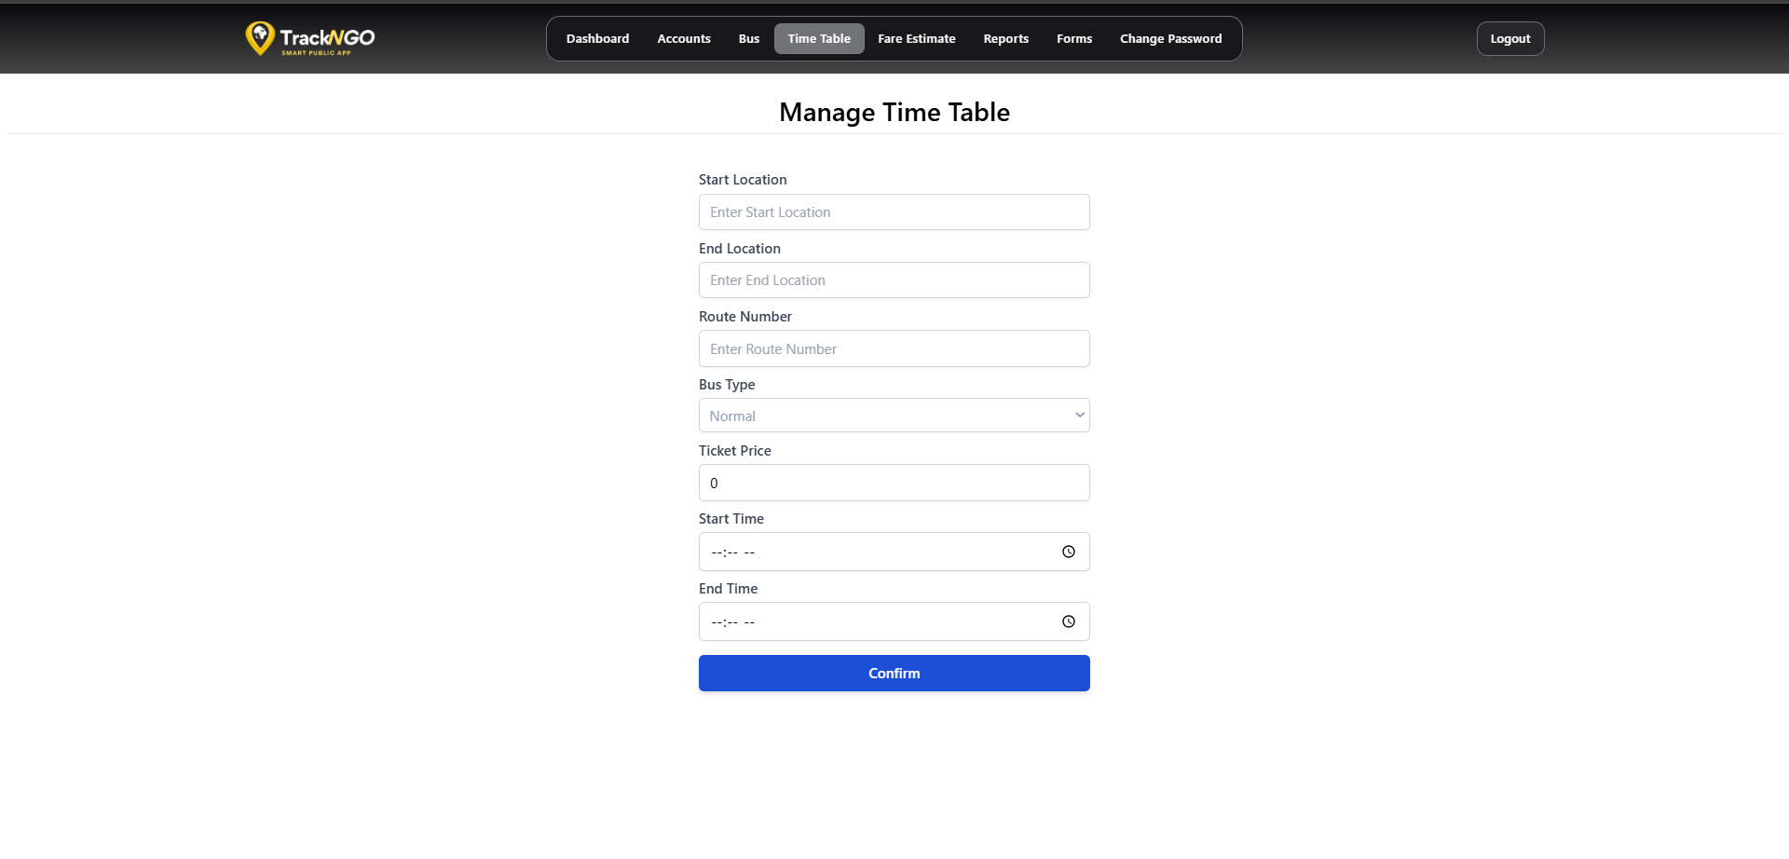
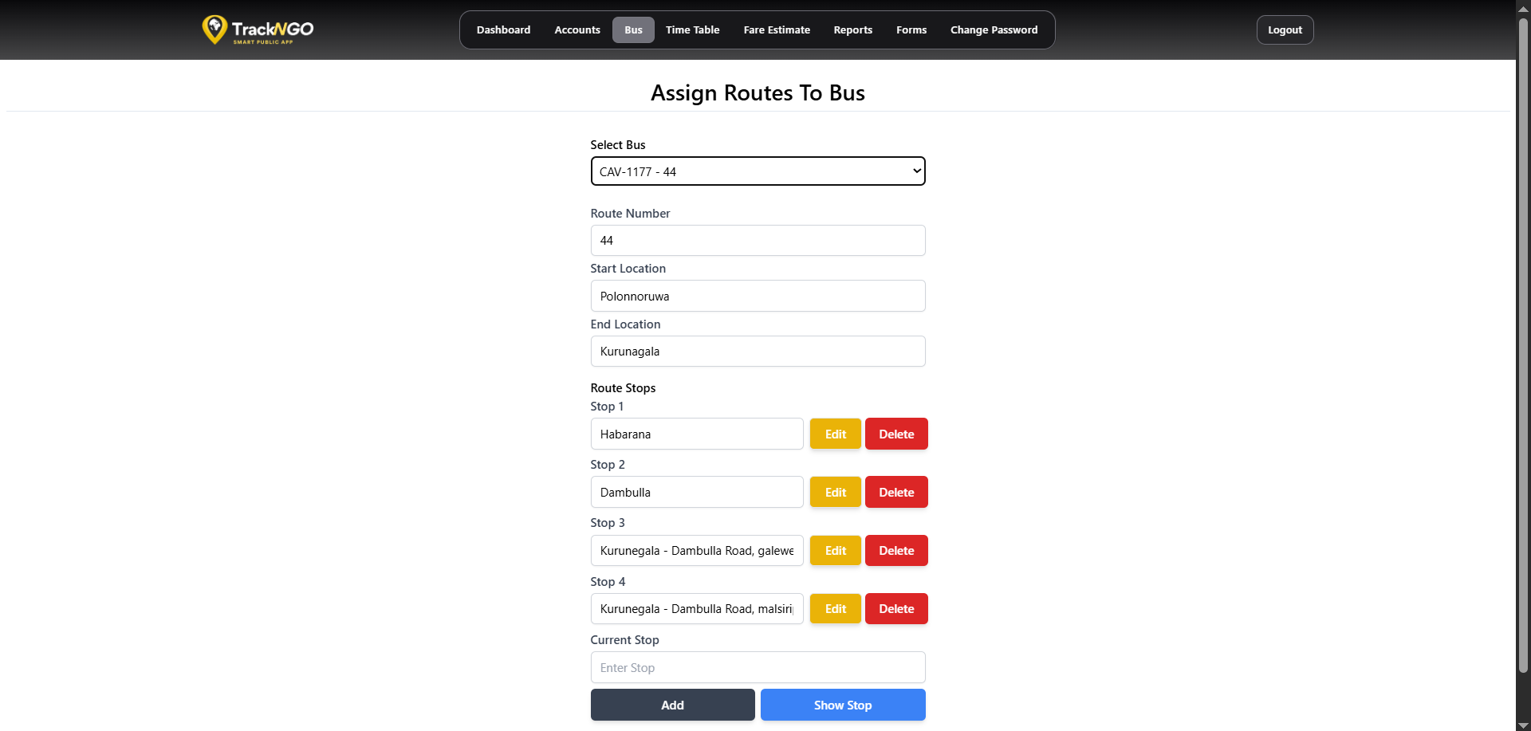
Final APP Interface

Slide 16
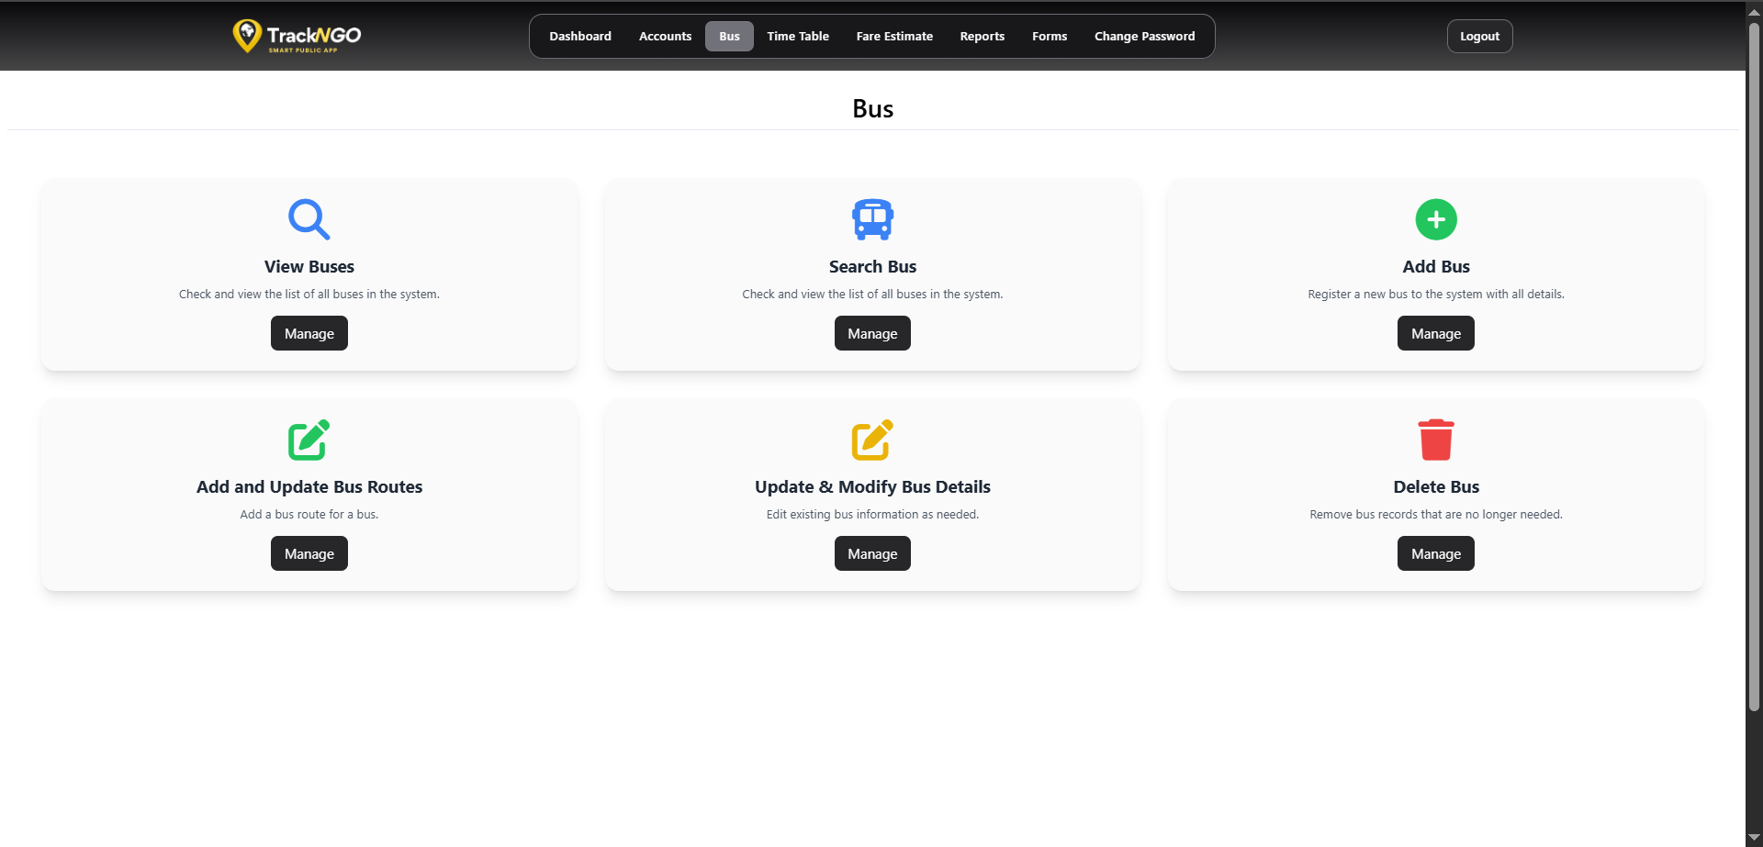
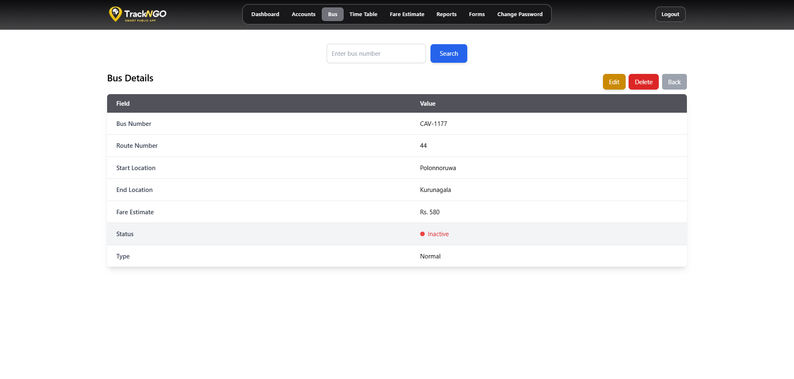
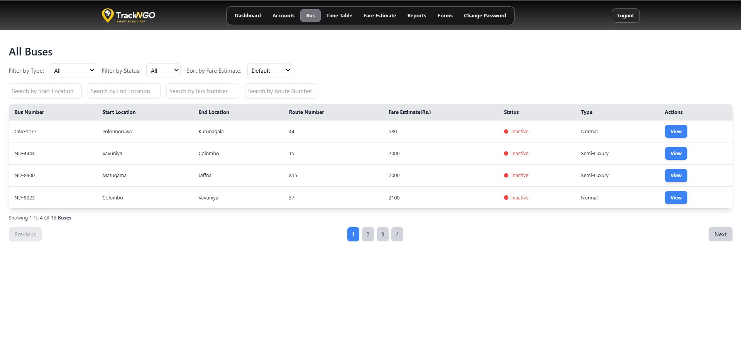
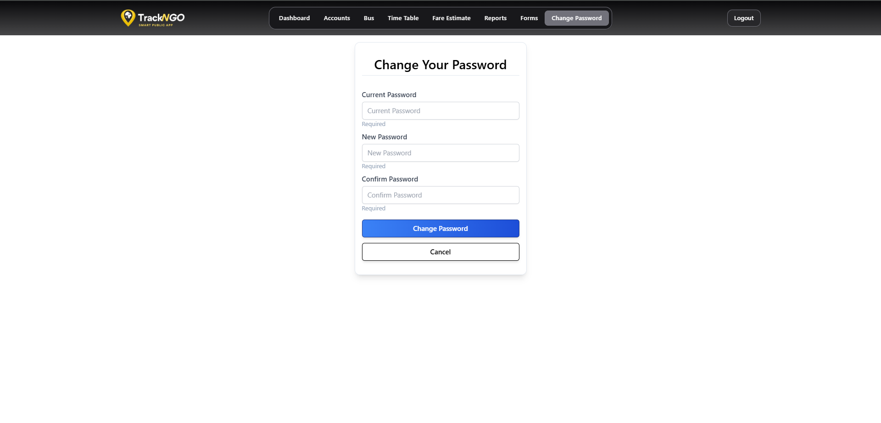
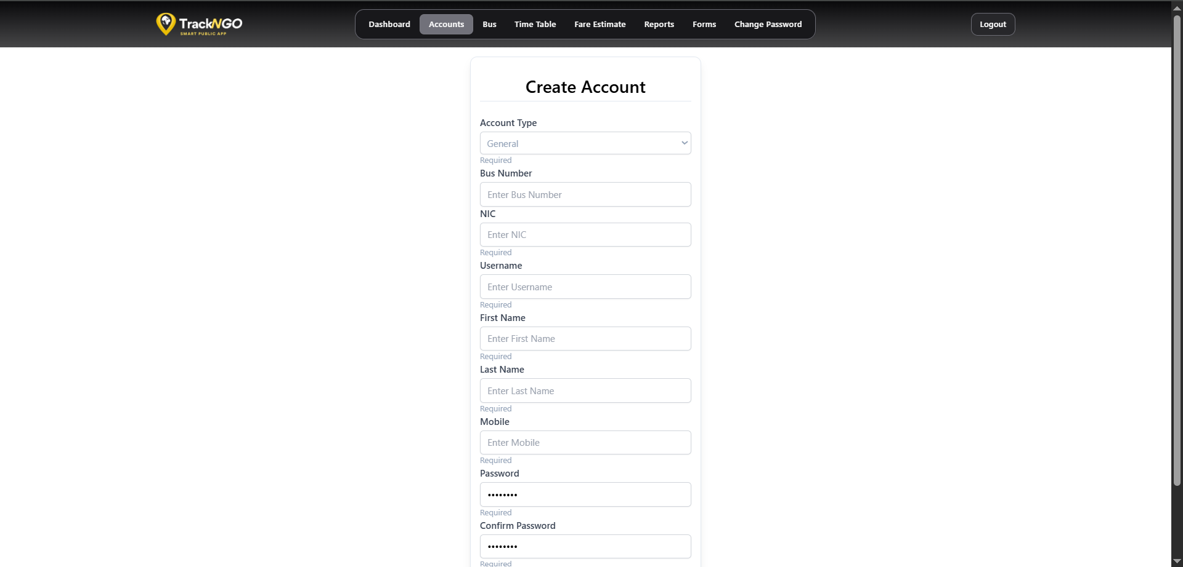
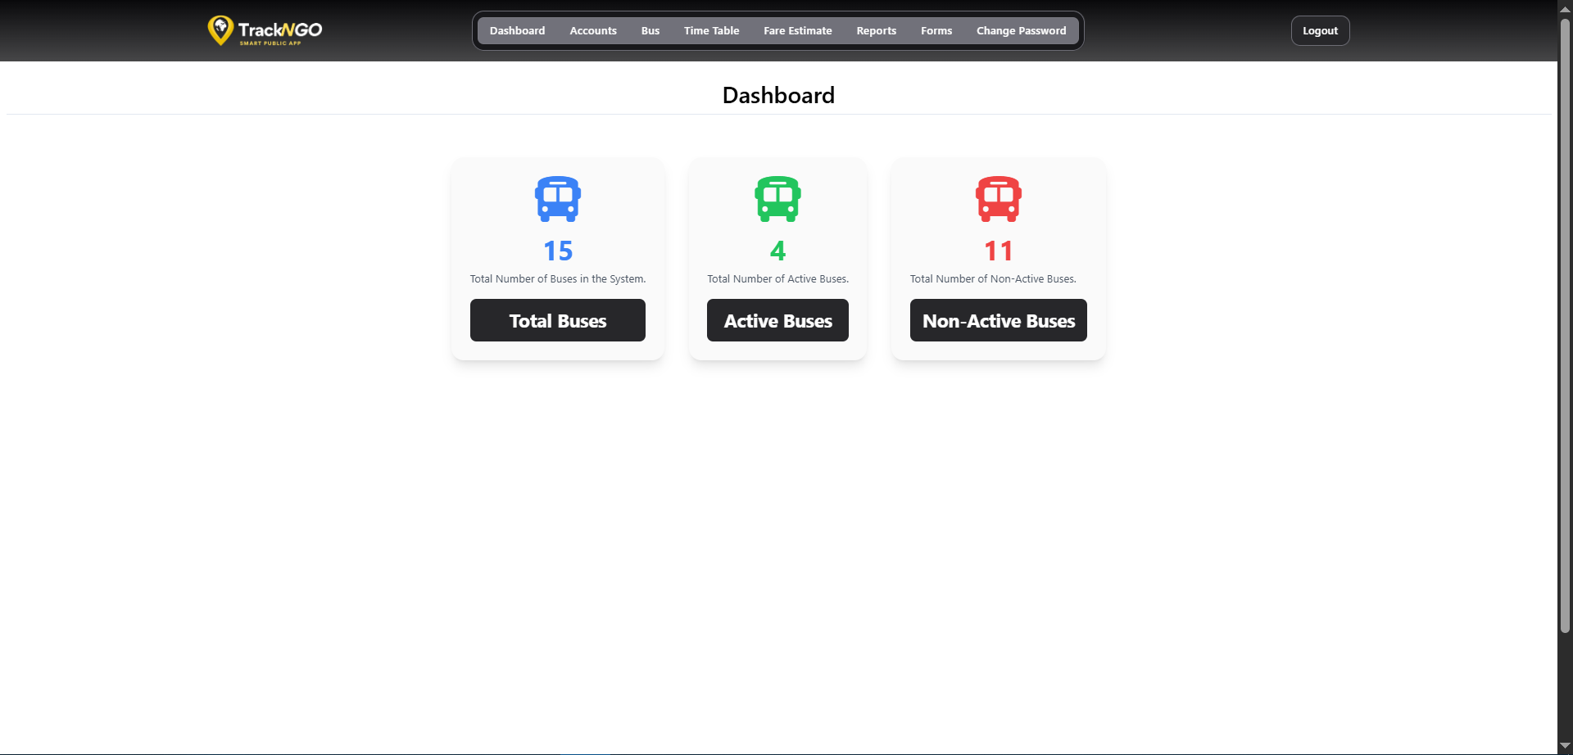
Final APP Interface

Slide 17
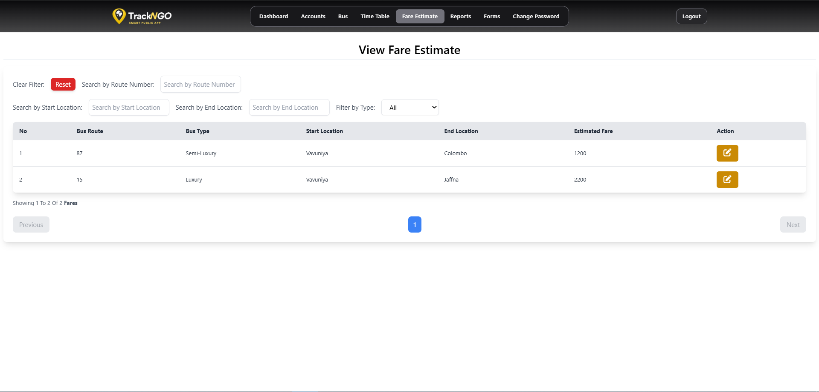
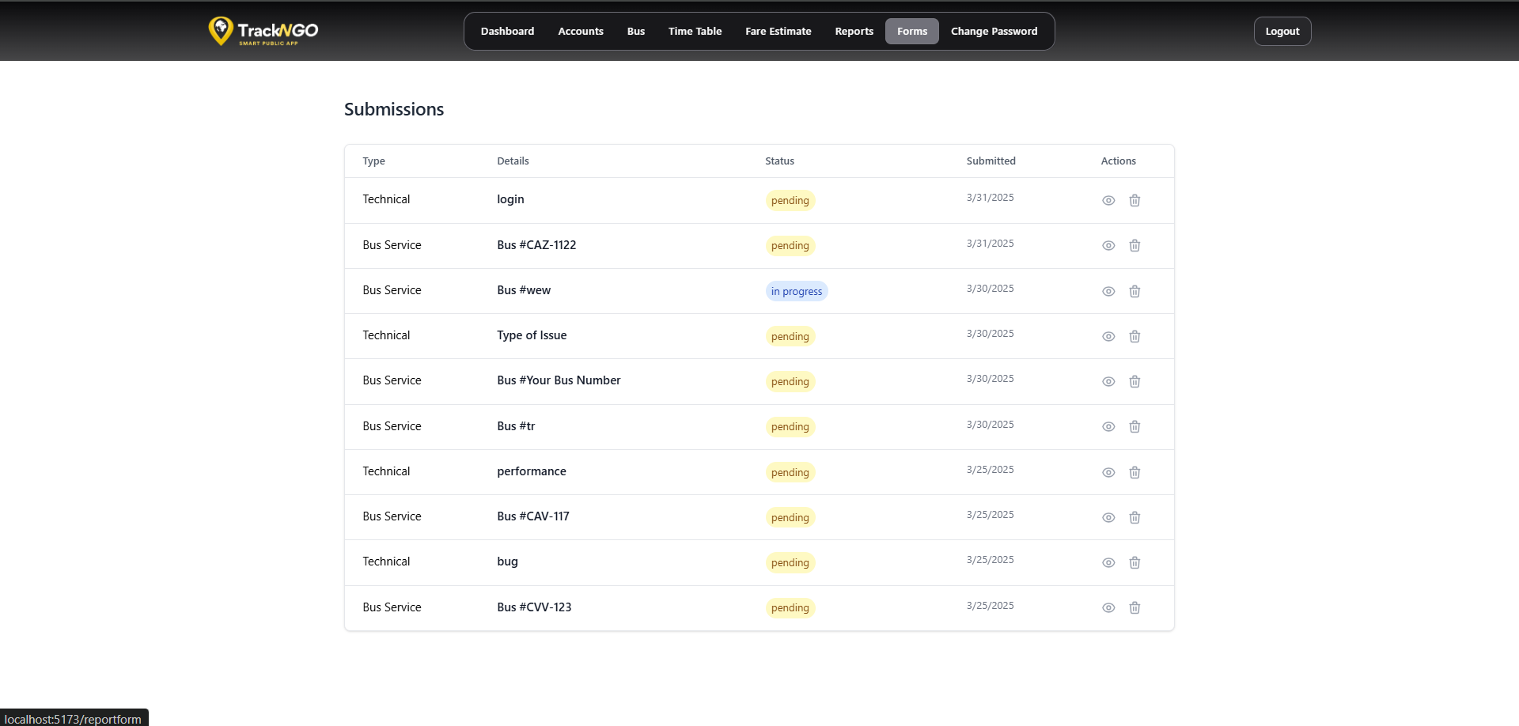
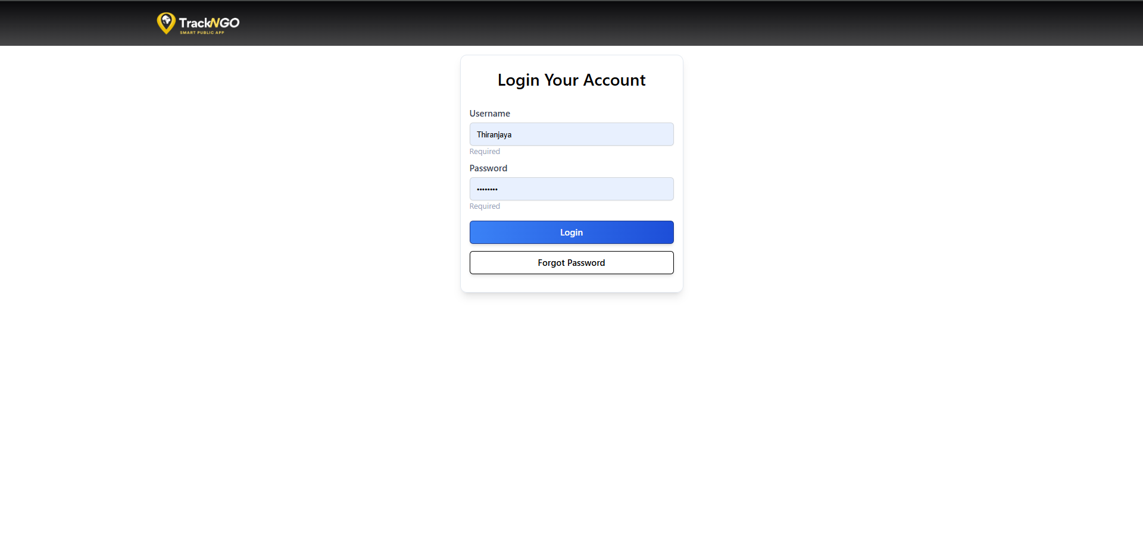
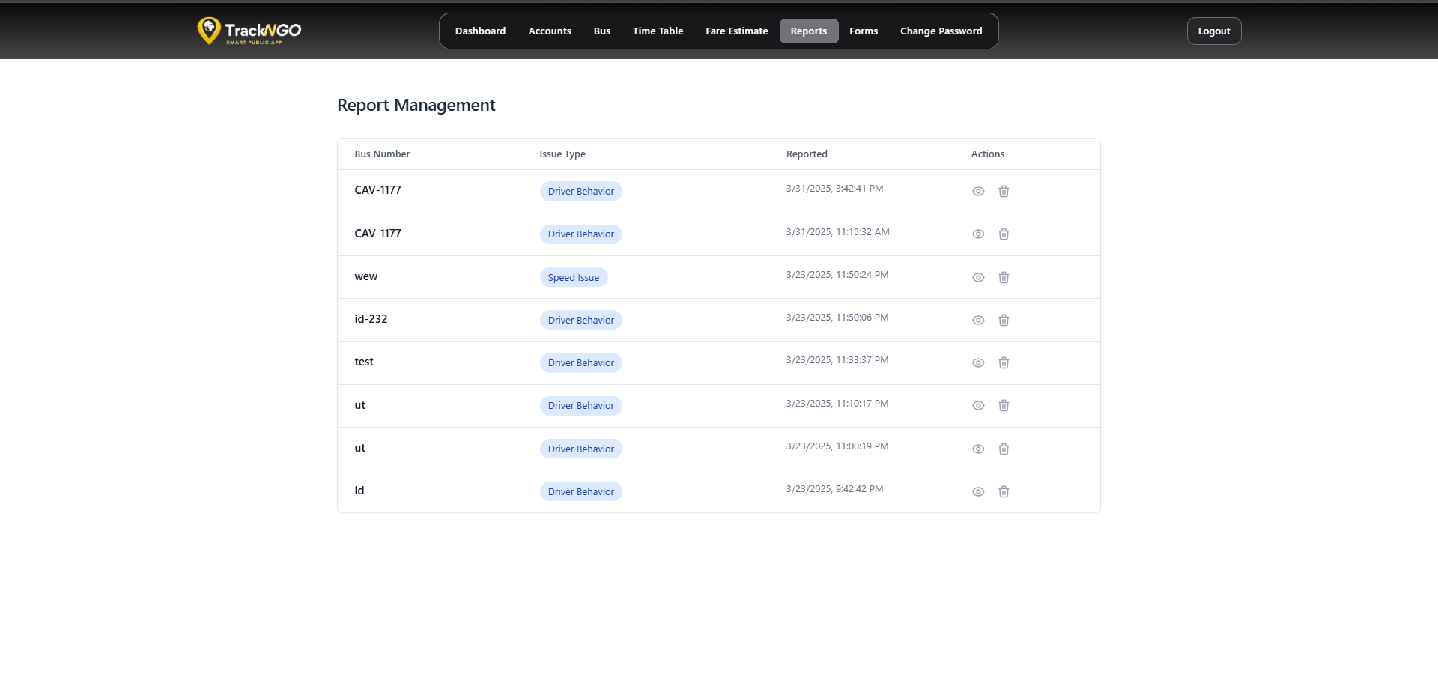
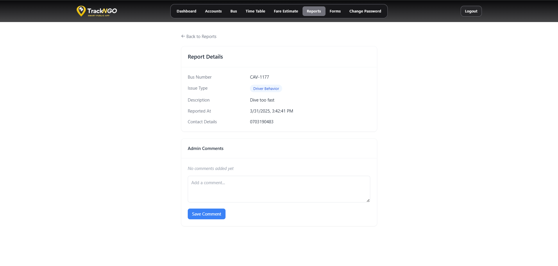
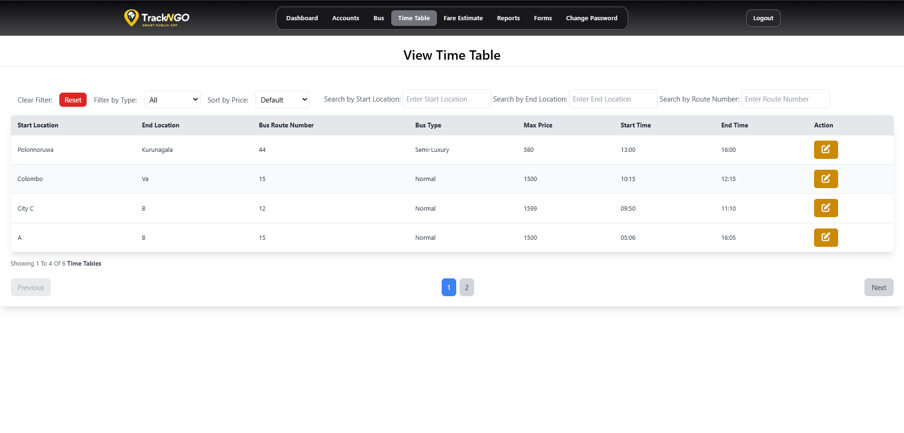
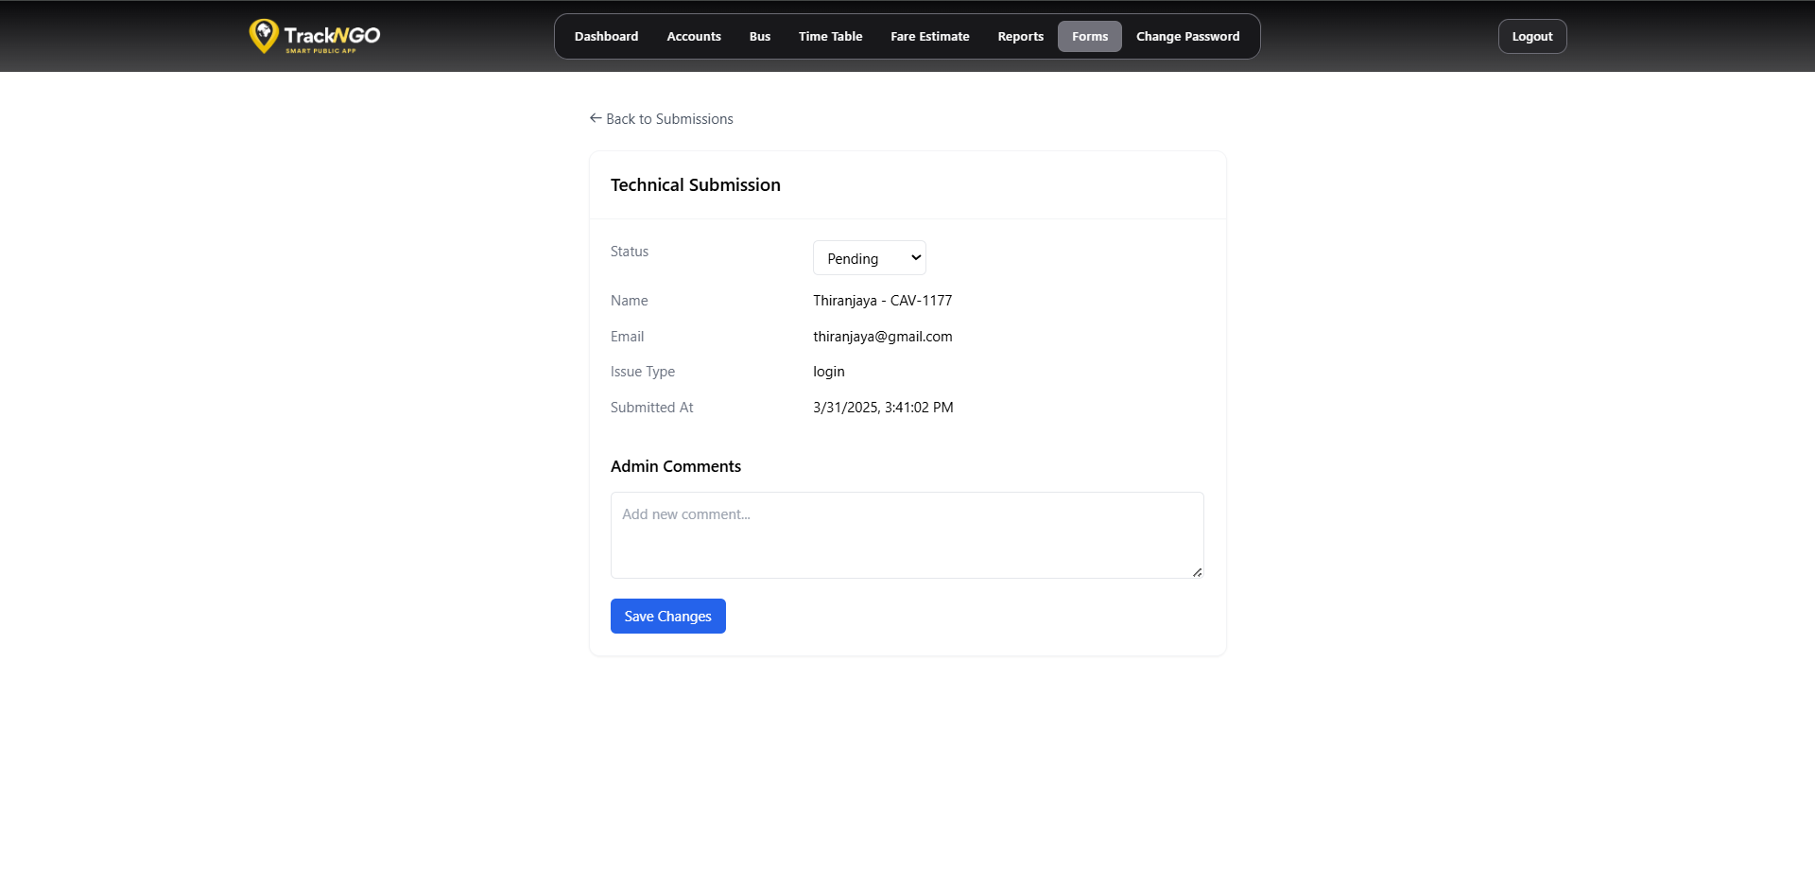
Final APP Interface

Slide 18
Future Works
Develop Conductor App as a native application.
Enhance real-time tracking & communication.
Integrate digital payments for convenience.
Expand features & scalability.

Slide 19
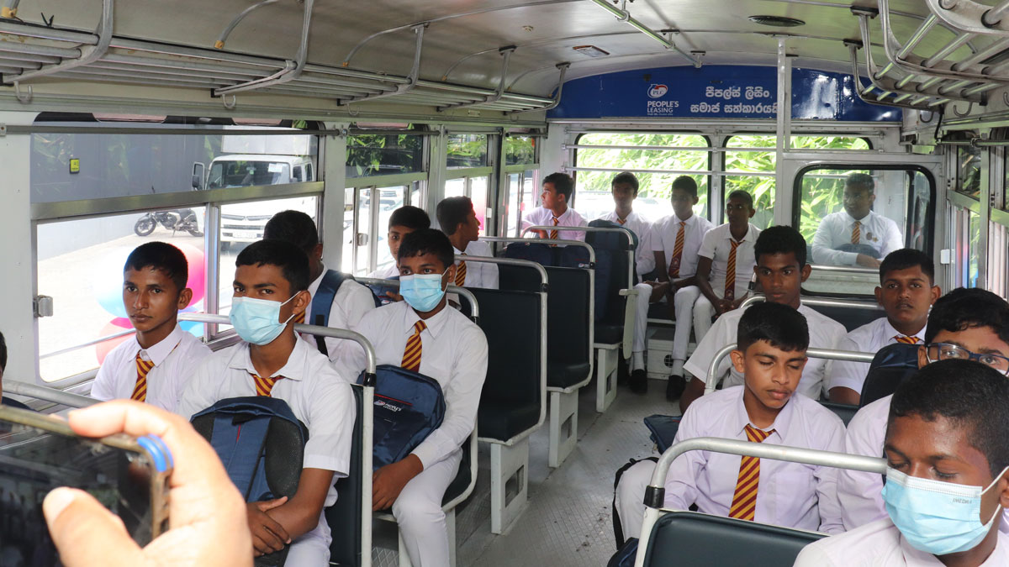


Conclusion
TrackNGo addresses key transit challenges with GPS tracking and real-time planning. By offering live bus locations, optimized routes. it aims to improve commuter satisfaction and build a more efficient, reliable public transport system in Sri Lanka.

Slide 20
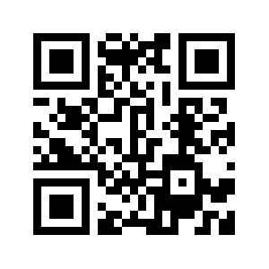
Scan to Access Github Repository
https://github.com/TrackNGo

Slide 21
Group Details
2020/ICT/07 - Mr. Nalawansa U.K
2020/ICT/49 - Mr. Bandara R.M.M.T.
2020/ICT/32 - Mr. Kalhara K.A.T.
2020/ICT/23 - Mr. Naveen P.R.
2020/ICT/118 - Ms.M.T.F.Shazna
2020/ICT/36 - Ms. Dhanapala D.M.C.S.
2020/ICT/88 - Ms. Perera KNR

Slide 22
Thank You

